Slide 2
Logistic Regression

Slide 3
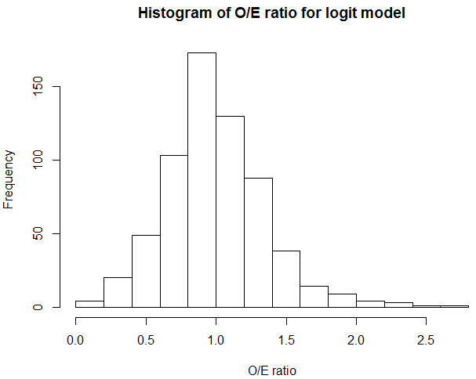

Slide 4
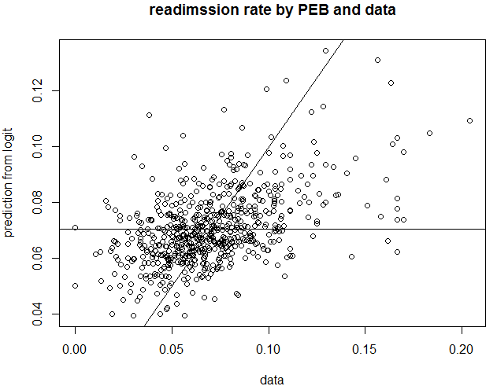
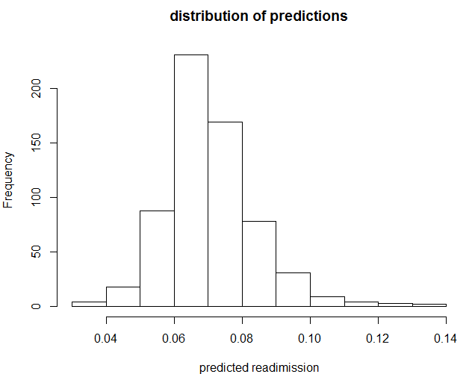

Slide 5
Parametric Empirical Bayes

Slide 6
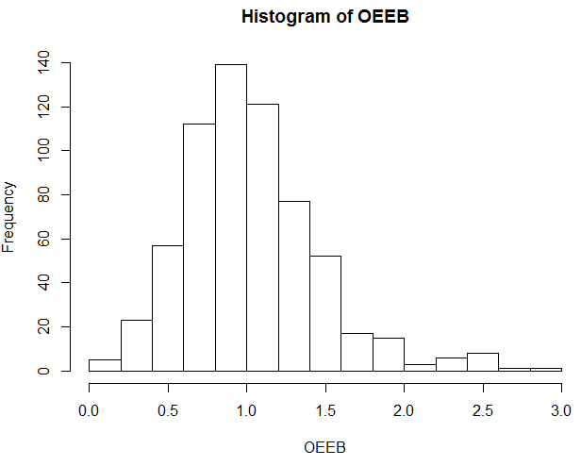

Slide 7
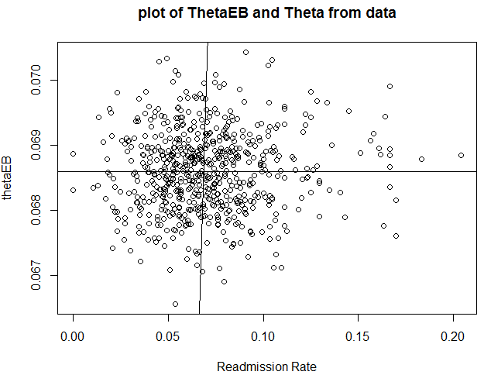
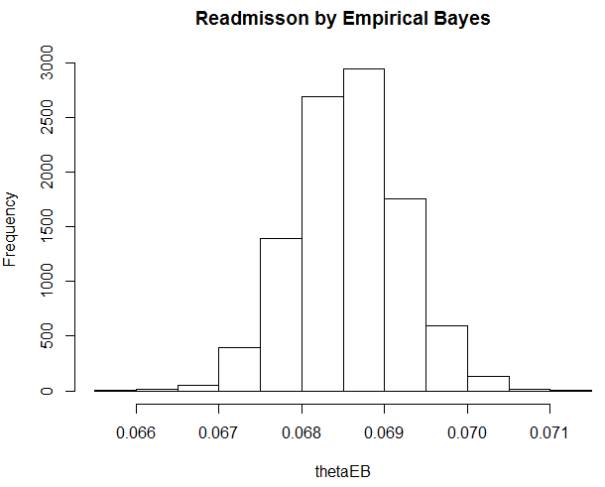

Slide 8
Nonparametric Empirical Bayes
Robbins (1956) considered a case of sampling from a mixed distribution, where probability is specified as Poisson distribution.
yi|θi ∼f(yi|θi)=Poisson(θi)
θi ∼p(·),
where i=1,...,k

Slide 9

Method
$E\left[θi | \vec{y}\right]=\int{θi∗p\left(θi | yi\right)dθi}$
$=\frac{\int{θi∗{θi}^{yi}∗e^{−θi}∗p\left(θi\right)dθ}}{\int{{θi}^{yi}∗e^{−θi}∗p\left(θi\right)dθ}}$ $= \left(yi+1\right)∗\frac{m\left(yi+1\right)}{m(yi)}$

Slide 10
Result
The average for overall estimated readmission rate is 0.0819;
The O/E ratio is 0.7392 with 95% CI (0.5137, 0.9119) (too far away from the observed data)

Slide 11
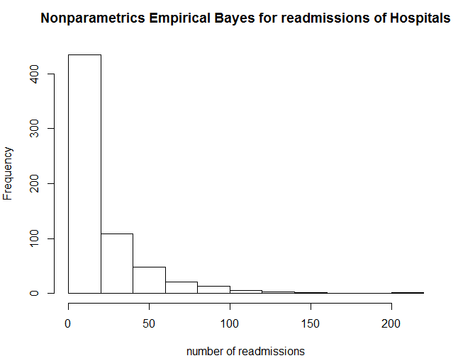
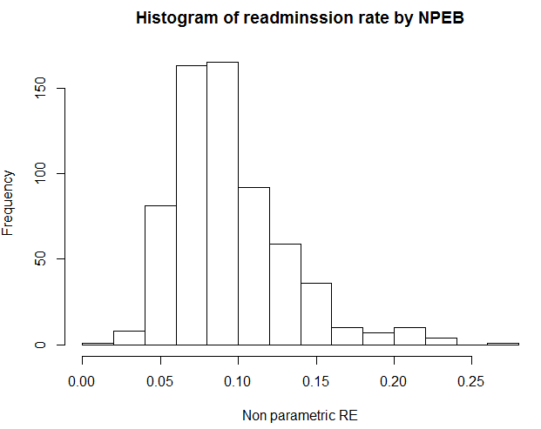
Result

Slide 12
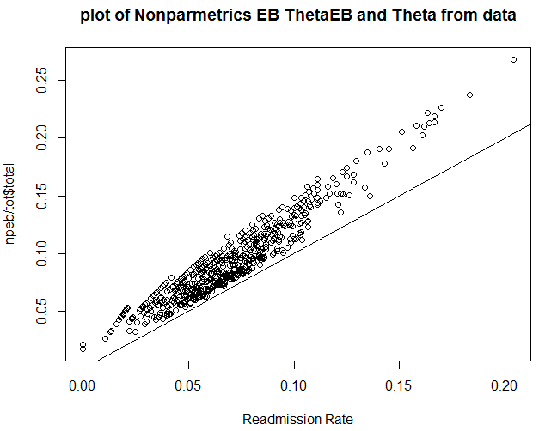
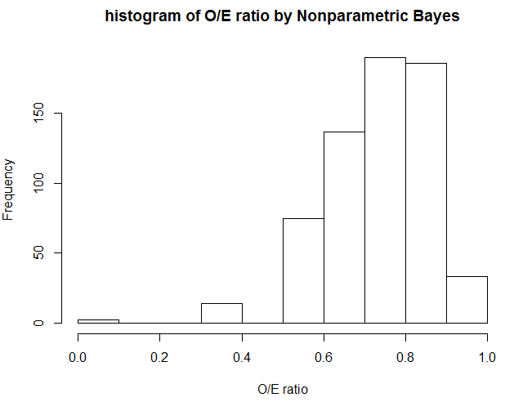
Result

Slide 13
Discussion
The 2-level model has O/E ratio 1.0027. That the predictions are close to data. But the estimations from NPEB are far away.
Comparing to PEB, the Poisson-gamma model generated by MCMC has

Slide 14
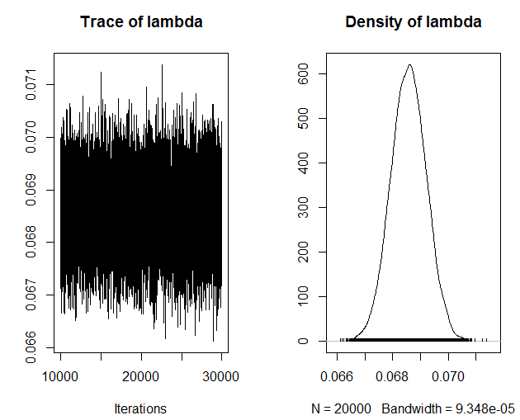
Discussion
Recall the MCMC:

Slide 15
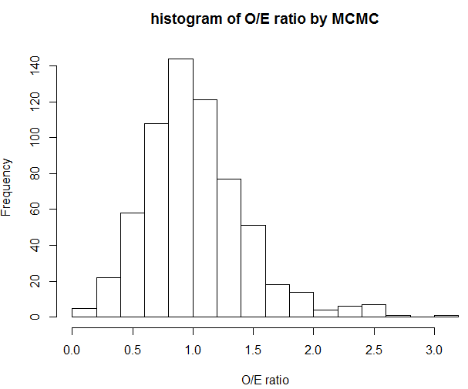
Discussion

Slide 16
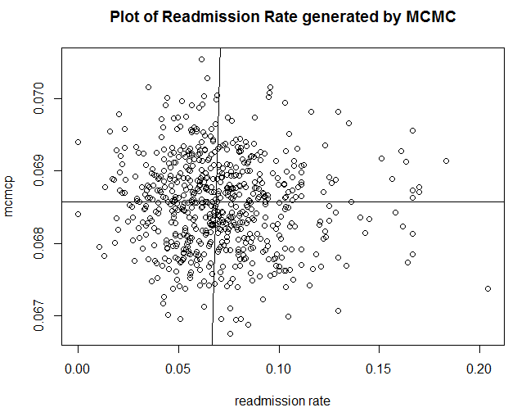
Discussion
Standard deviation= 0.0367
Standard deviation= 0.0006

Slide 17
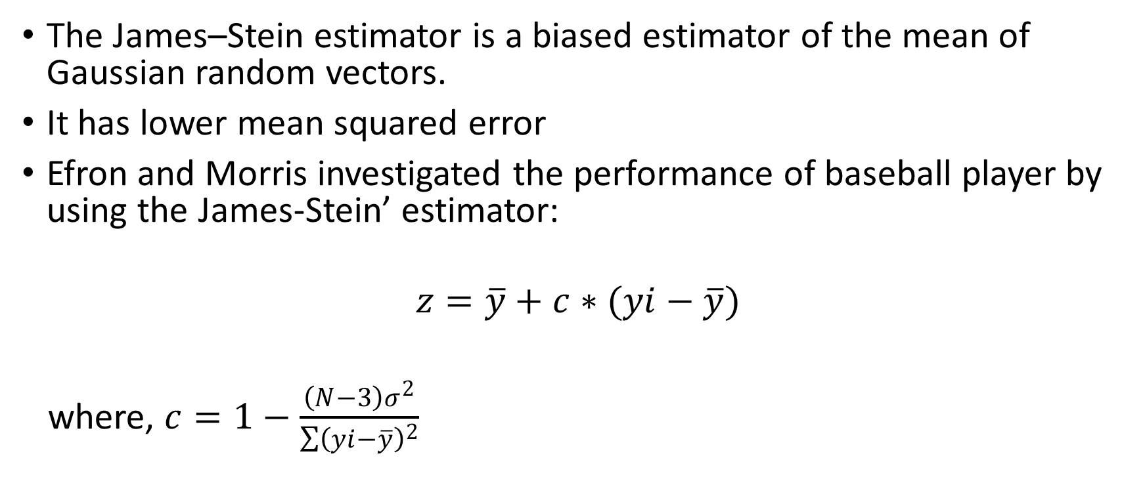
James-Stein Estimator
The James–Stein estimator is a biased estimator of the mean of Gaussian random vectors.
It has lower mean squared error
Efron and Morris investigated the performance of baseball player by using the James-Stein’ estimator:
$$z=\overline{y}+c∗(yi−\overline{y})$$
where, $c=1−\frac{\left(N−3\right)σ^{2}}{\sum{{\left(yi−\overline{y}\right)}^{2}}}$

Slide 18
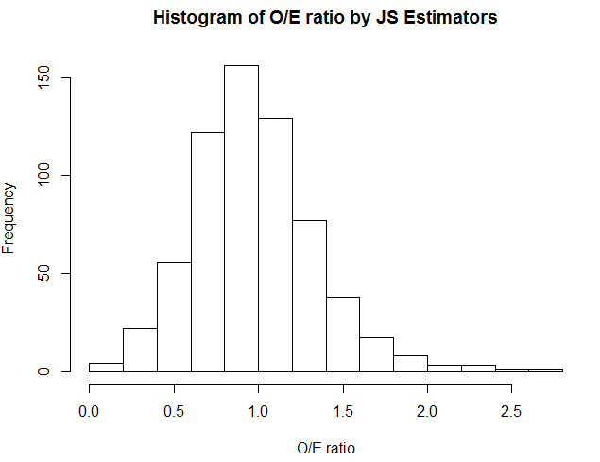
Result
The O/E ratio is 0.9770
With 95% CI (0.3447,1.799)

Slide 19
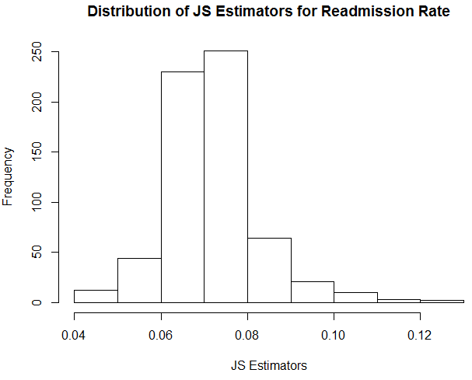
Result
The estimated average of
Readmission rate is 0.0717

Slide 20
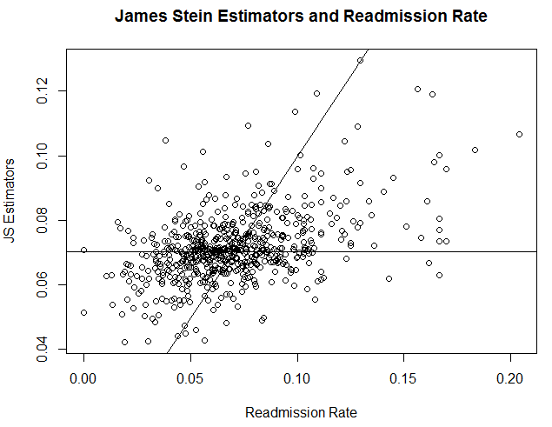
Result
Standard deviation = 0.0108

Slide 21
Discussion
O/E ratio is approximately 1, which shows good fitness for the data.
MSE(JS)/MSE(Logit)= 0.1360, means the MSE has been reduced dramatically.

